Slide 1
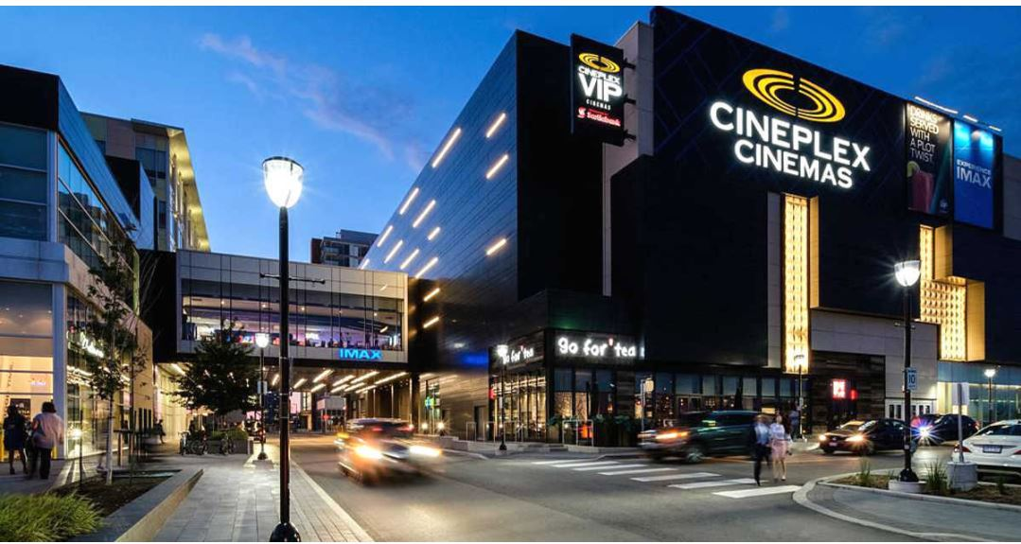

Cineplex Inc.
When Cineplex⁺ Data
C⁺D Team Project

Slide 2
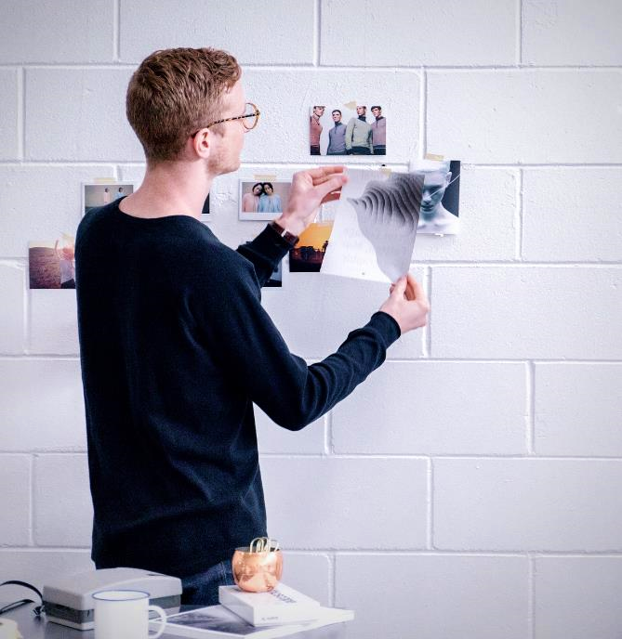
Today’s Cineplex
Business Model Canvas & Annual Report
Insights in Data
Bill’s Advice & SWOT analysis
Our Solutions
OUR
AGENDA
Projects detail & ROI & Value proposition
Project Planning
Data Team & Road Map & Challenges
Our Team
C+D = E+F (Entertainment Future)

Slide 3
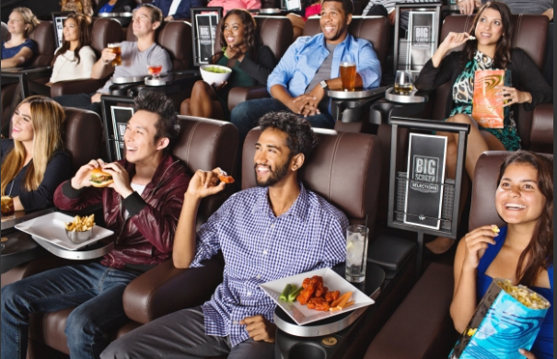
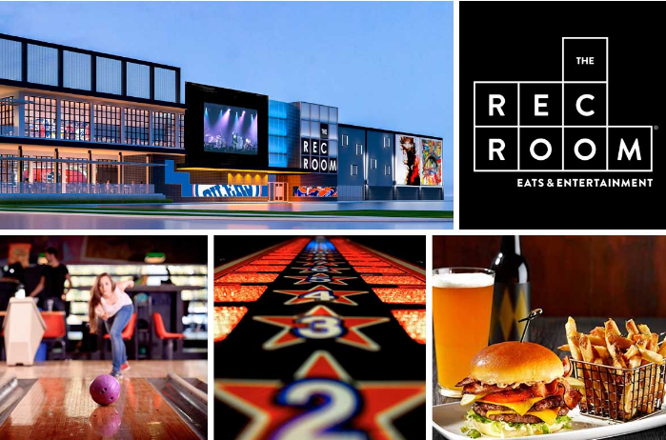
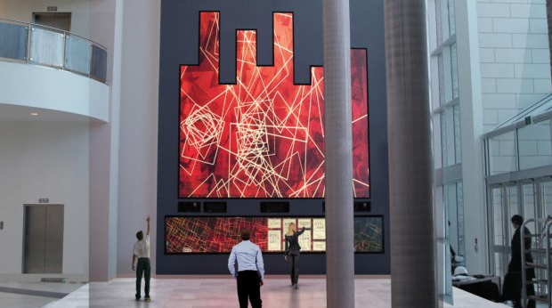
Today’s Cineplex
Company Vision
Cineplex remains confident in the company’s strategic direction to diversify beyond exhibition and expand core strengths into other entertainment and media offerings.
---- Chair of the Board Ian Greenberg
Film Entertainment and Content
Amusement and Leisure
Media

Slide 4
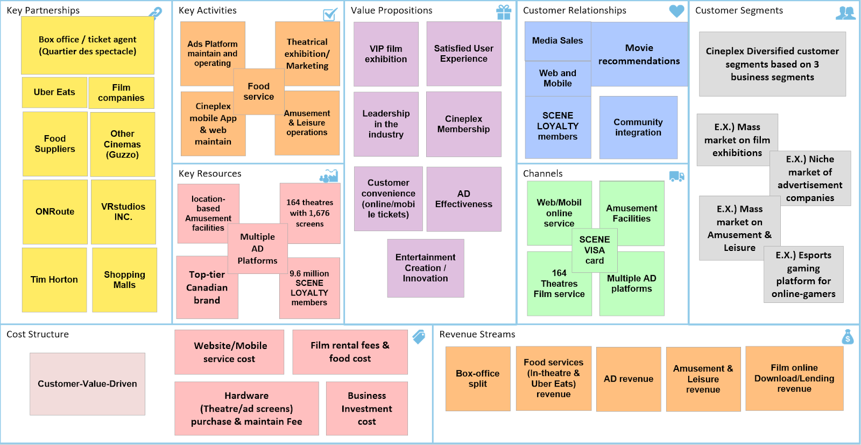
Today’s Cineplex
Business Model Canvas

Slide 5
Today’s Cineplex
2018 Annual Report
In 2018, Cineplex Total revenue increased 3.8% to $1.6 billion.
Annual box office revenue increased 1.2% to $724.2 million. Theater food service revenue increased 4.4% to an all-time record of $440.7 million. Amusement revenue increased 11.0% to $205.8 million.
Media revenue Decreased 4.0% to $165.0 million.

Slide 6

complied with company’s general strategies, fully understand of business model, analyzed the annual state of operation, considering existing data, we will focus on our initiative of
Operation Status
Company’s Vision
Business Model
Initiative:
Increasing Media Revenue
Today’s Cineplex
v

Slide 7
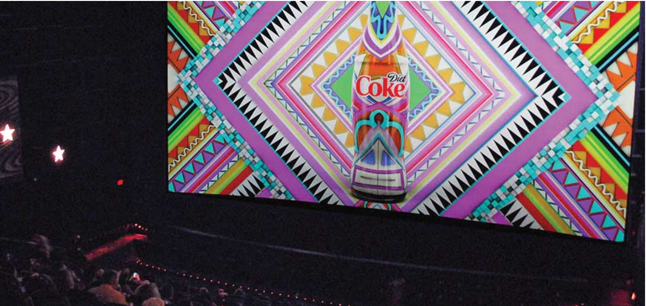
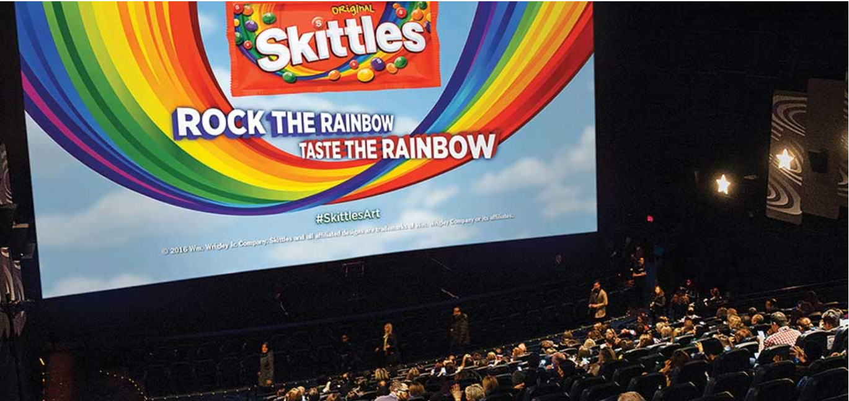
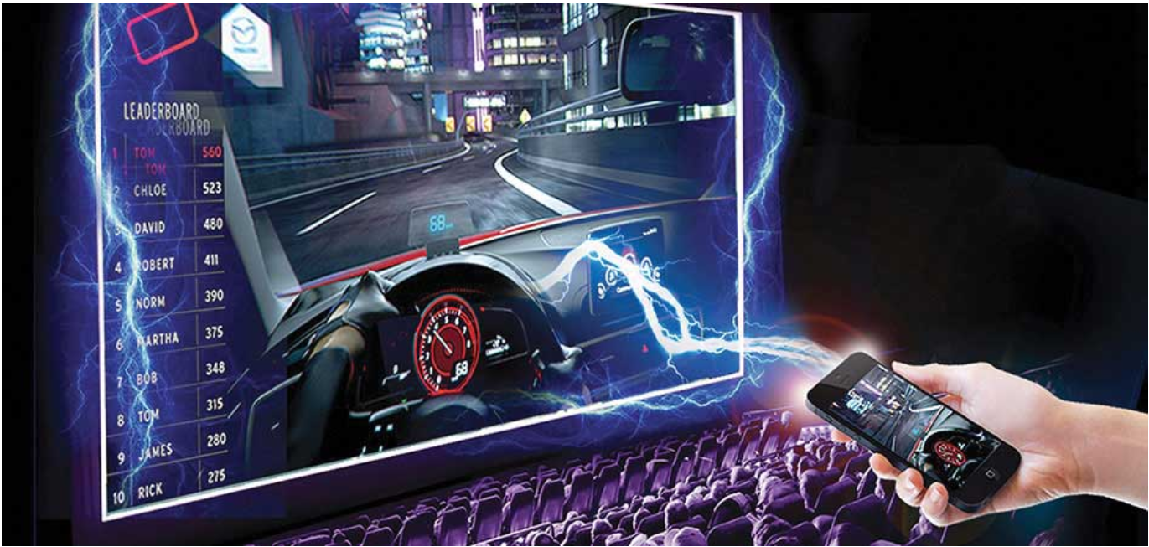
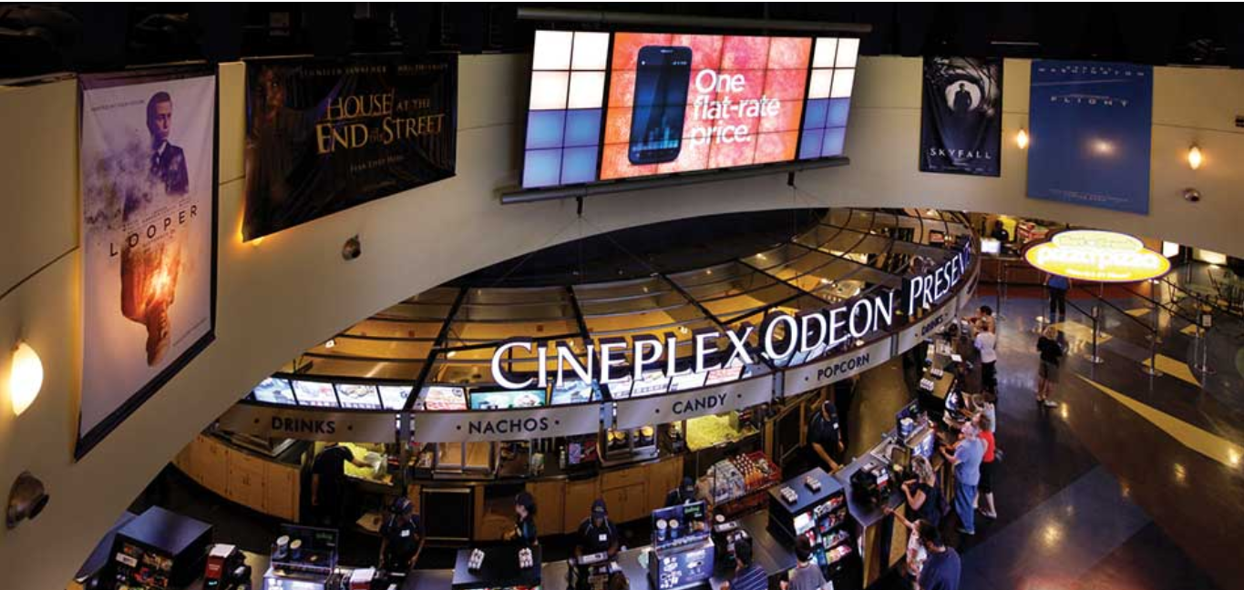
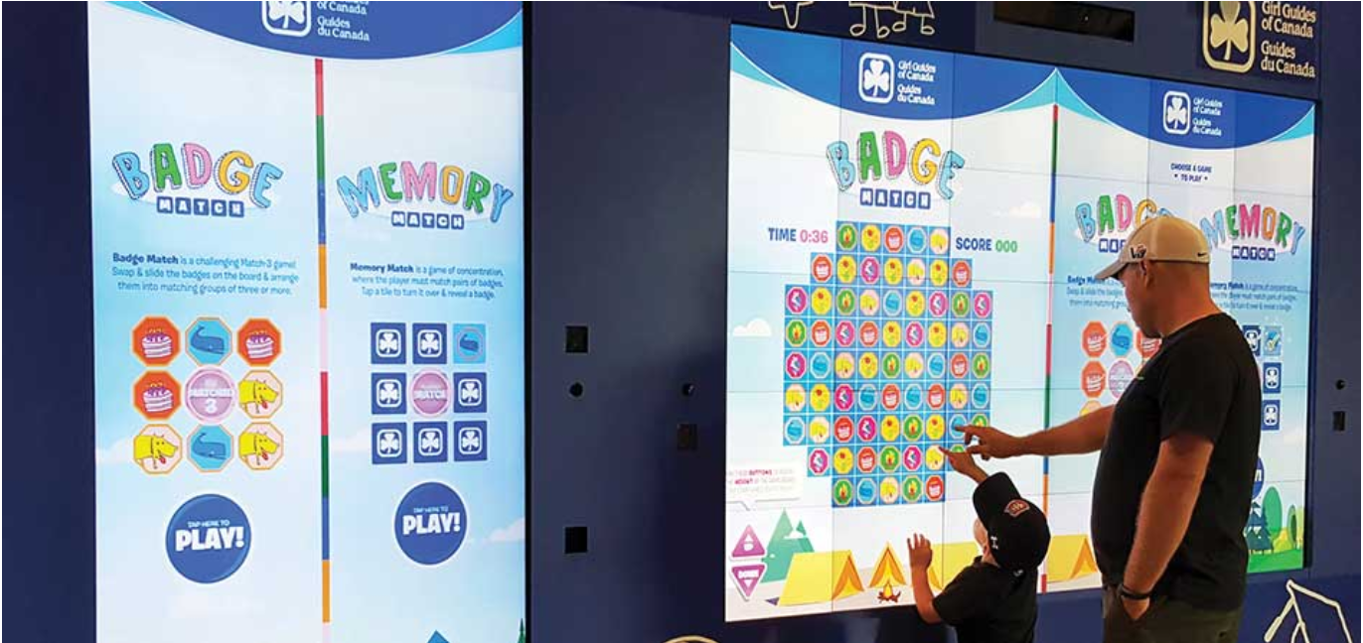
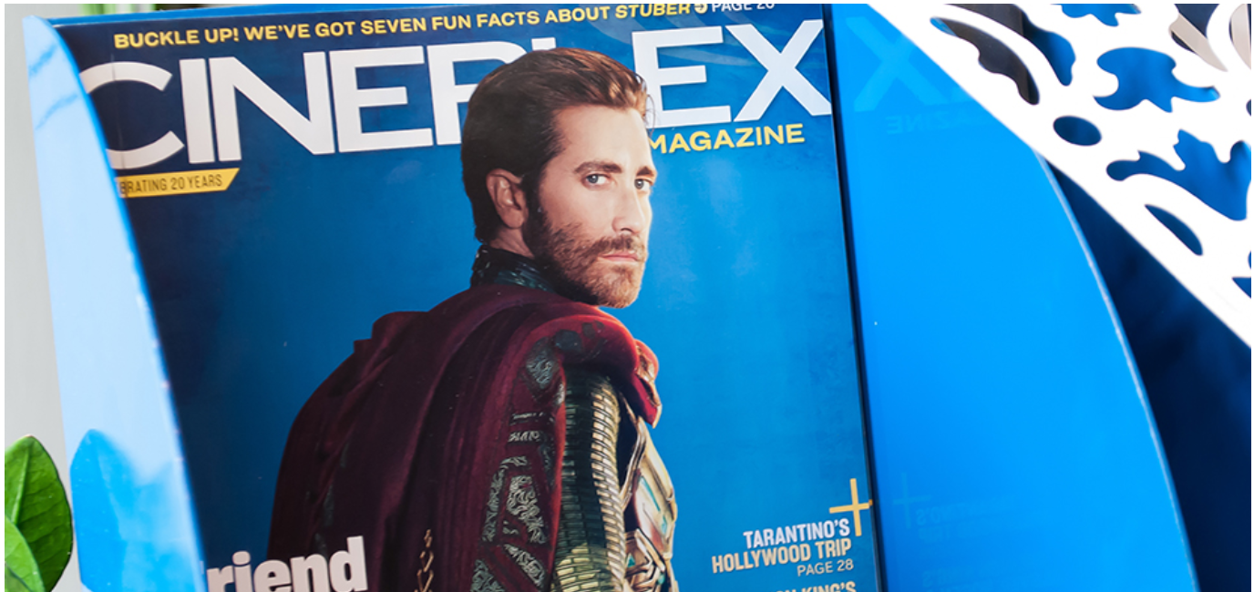
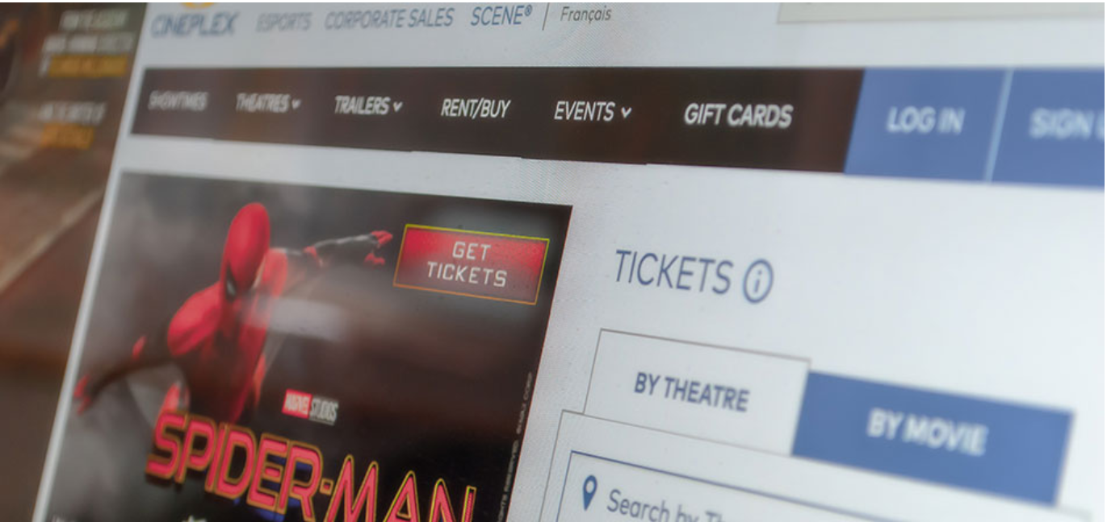
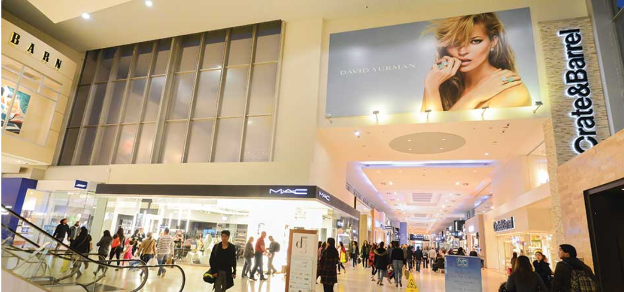
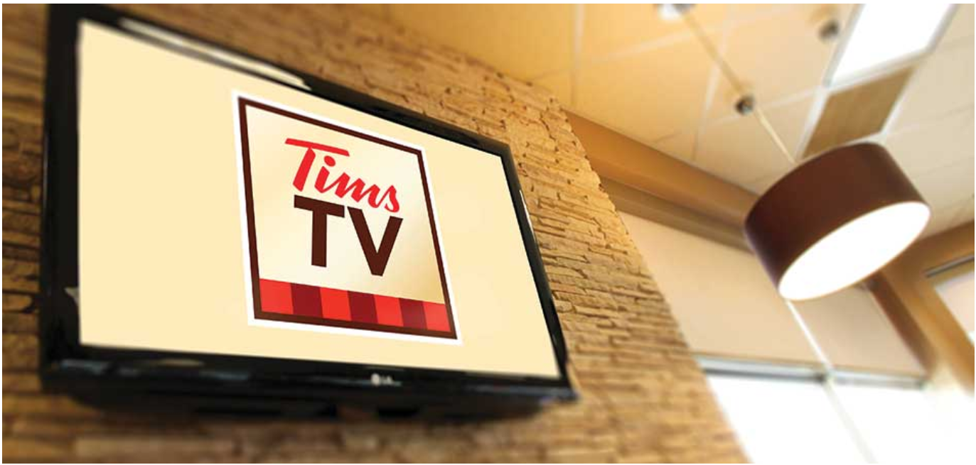
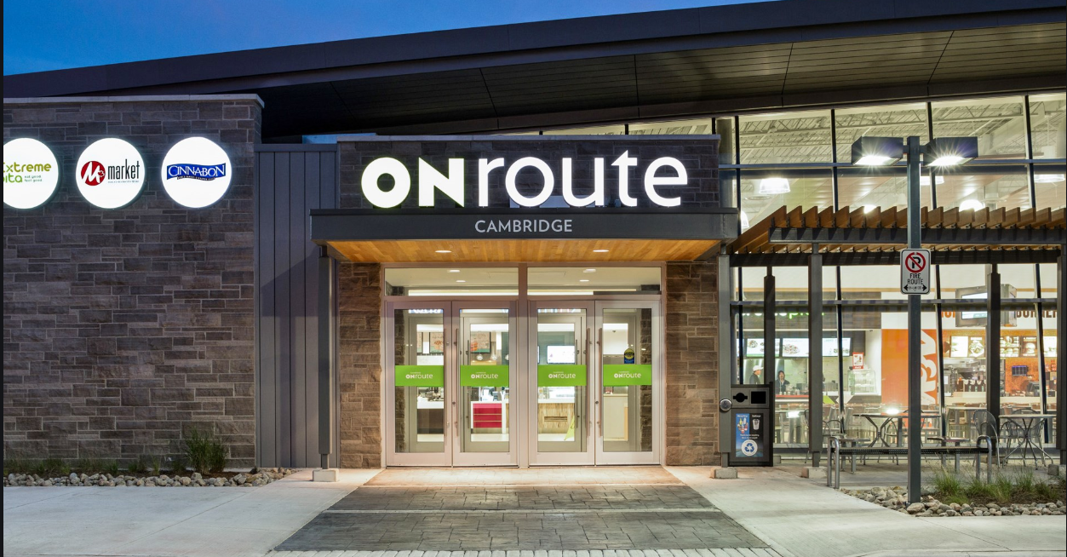
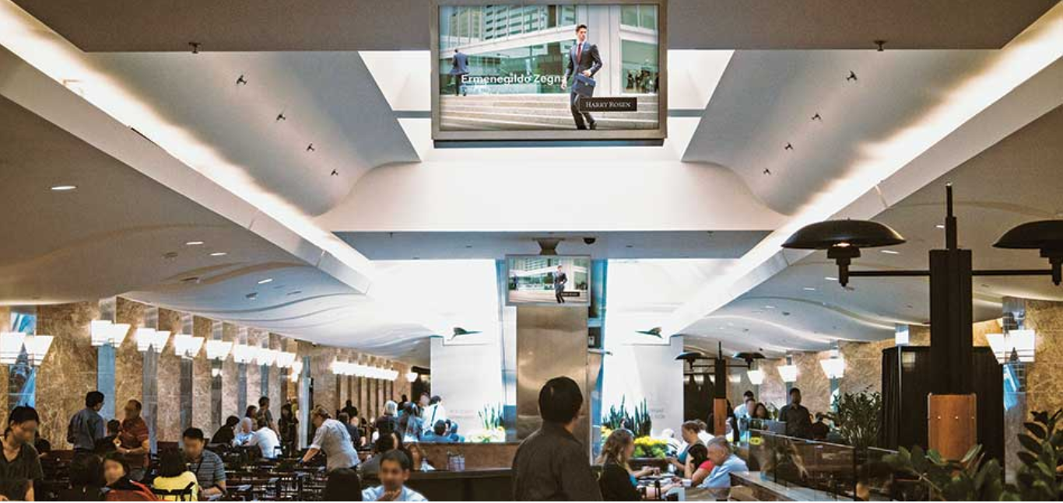
Insights in Data
Uncle Bill’s Advice
Cineplex Media
7 properties of Cinema Media
01
Show-Time
02
Pre-Show
03
TimePlay
04
Digital Lobby
05
Interactive zone
06
Magazine
07
Online & Mobile
4 properties of Digital-based media
01
Shopping Mall
02
Tims TV
03
ONroute
04
Concourse Network

Slide 8
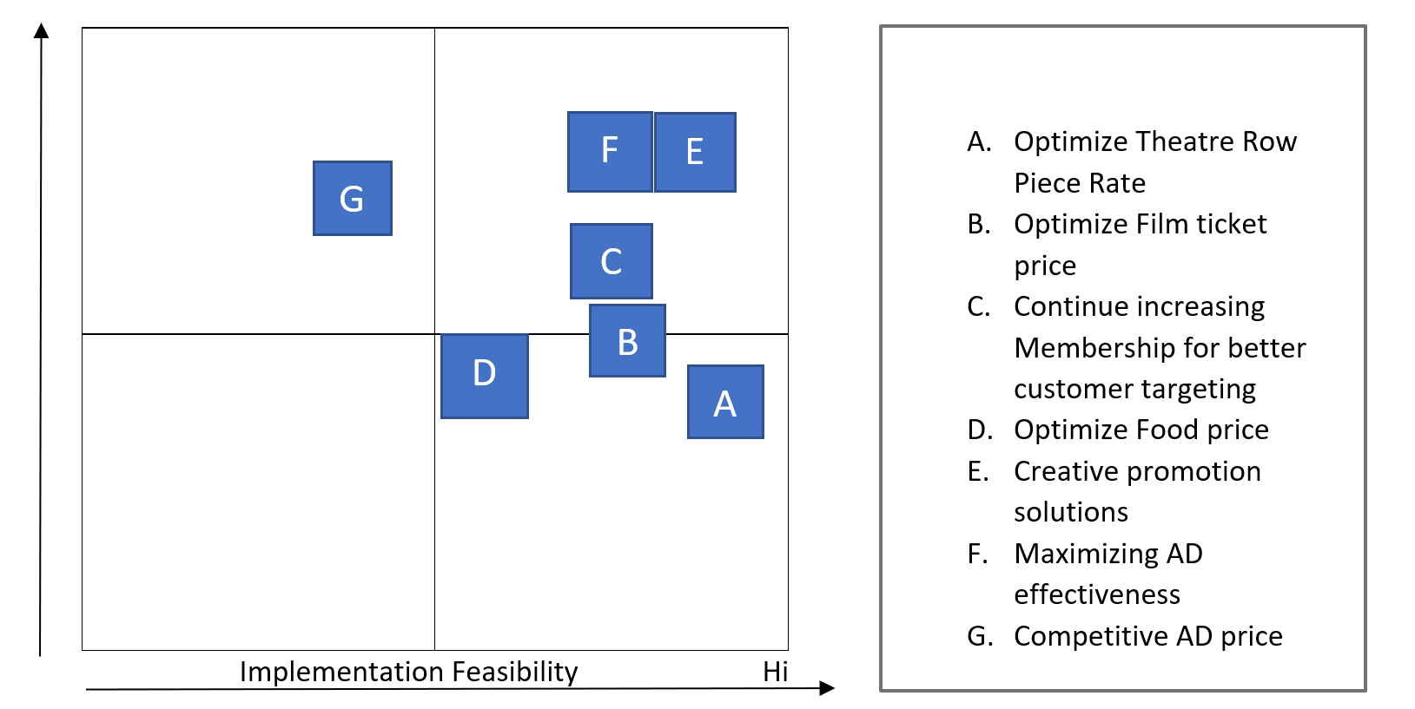
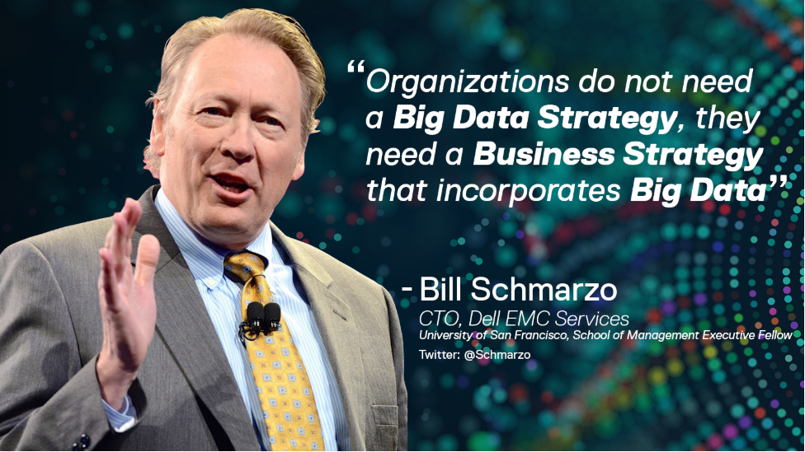
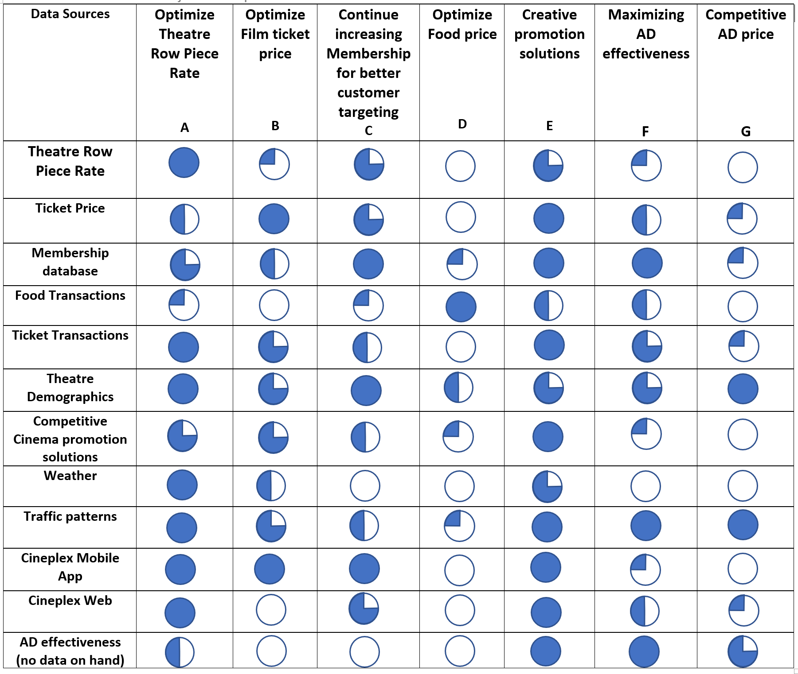
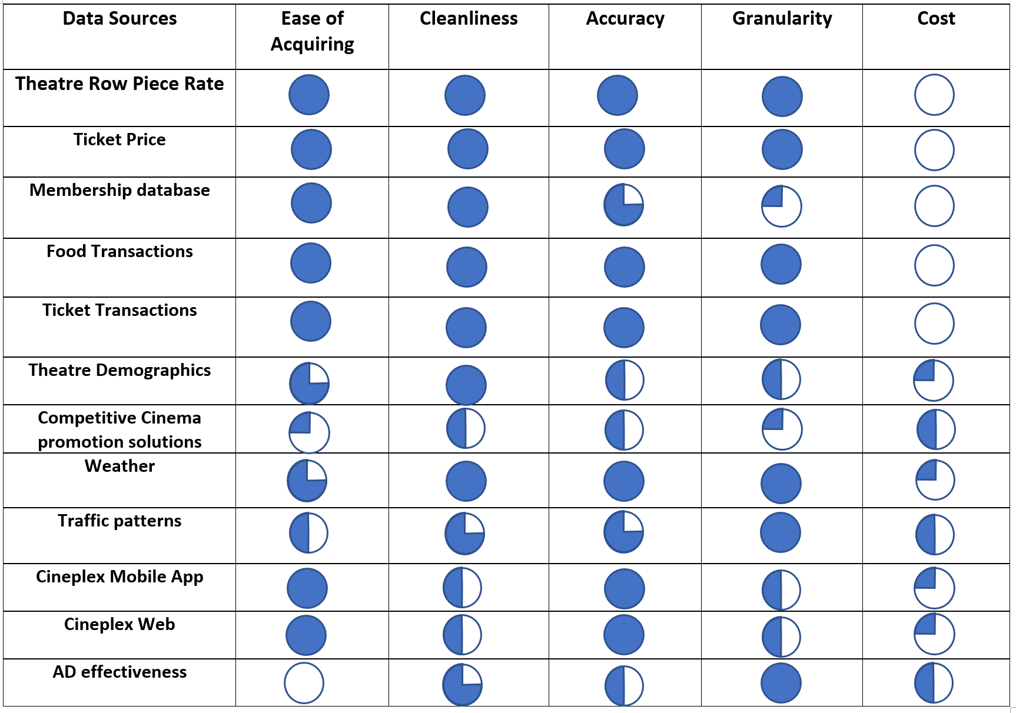
Insights in Data
Uncle Bill’s Advice
3. Prioritization Matrix
Business Value
1. Assess the potential business value
2. Implementation feasibility assessment
Our strategies
02
01
Maximizing AD effectiveness
Creative promotion solutions

Slide 9
Insights in Data
SWOT analysis
Internal
S
Internal
Strengths
W
Weaknesses
External
Opportunities
O
T
External
Threats

Slide 10
Insights in Data
SWOT Analysis
S
Strengths
W
Weaknesses
High market share on theatre industry, it is Canada’s largest Film Exhibitor.
Gold class film service offers a unique User experience. (Most advancing hardware, variety of food, online tickets, etc.)
Convenient Locations
Diversified business
Strong Profitability support Cineplex to have sustainable innovations
Loyalty membership to retain repeat customer
High level of ‘red tape’ to clarify from authorities
Difficulty in attracting new customer to increase traffic in theatre business
No digital platform for advertisement companies
Some theatres with Traffic congestion or lack of supporting facilities
(Lack of restaurants and shopping malls, etc.)
O
Opportunities
T
Threats
ITunes, Netflix, on-line streaming (Film & TV shows) lead to lower sales.
Weather conditions (Special in Winter in Canada)
High Entertainments Taxes
Restrictive Licenses if the ‘red tapes’ are not approved by authorities
Policy restrictions (Alcohol restrictions, Movie screening licensing, parking numbers restrictions)
High entertainment requirements from consumers, which provide a broad potential market to develop
Increased Disposable Income
Low market competition
The preference of film is becoming various

Slide 11
Our Solutions
Difficulty in attracting new customer to increase traffic in theater business
No integral Platform for advertisement companies
Solution 1
FREE MOVIES if you watch Ads on your smart phone.
Solution 2
Build up an integral DIGITAL PLATFOM for Media offering consultations and Ads monitoring.

Slide 12
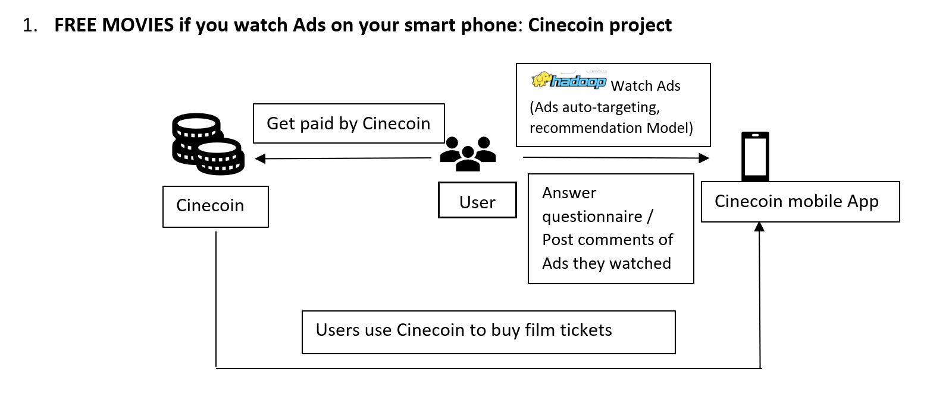

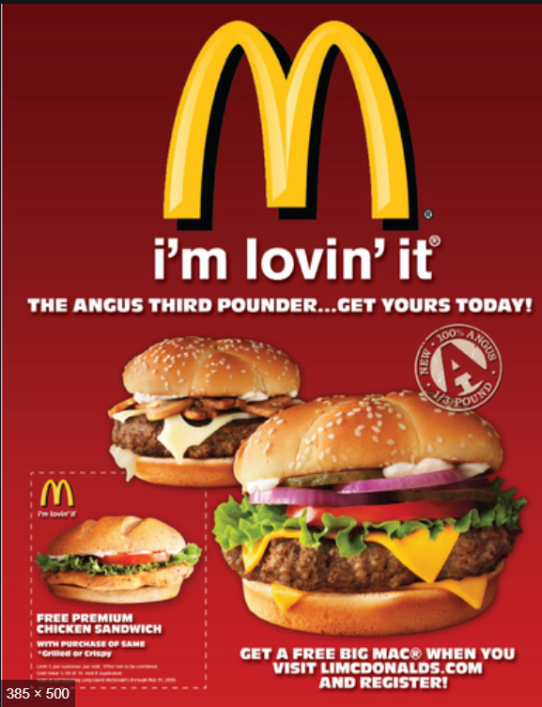
Our Solutions
Cinecoin Project

Slide 13
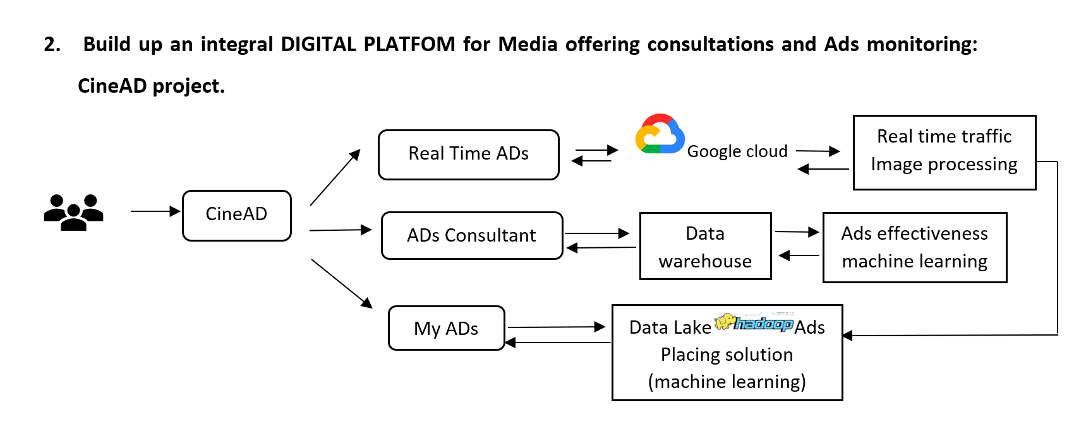
Our Solutions
CineAD Project

Slide 14
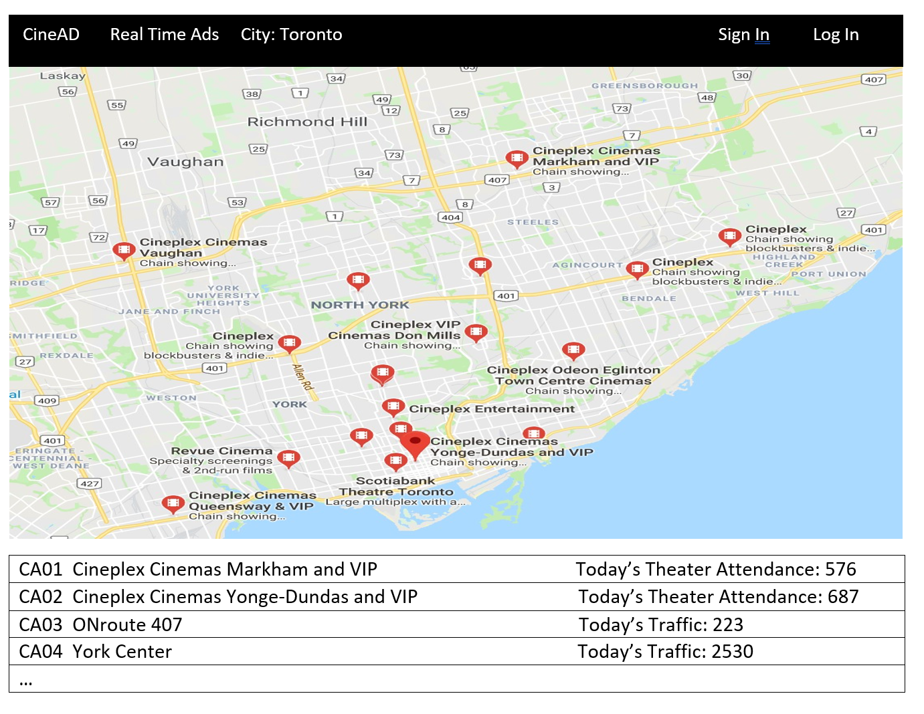
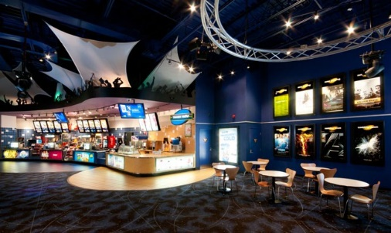
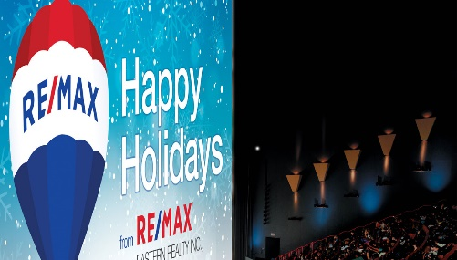
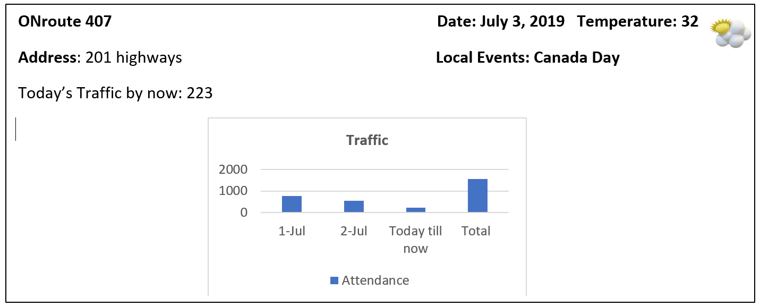
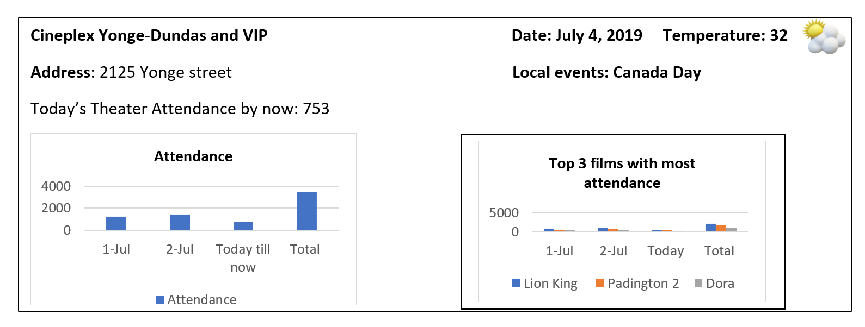
Our Solution
CineAD project
Real Time Ads :
Show generally all Cineplex AD operation dashboard, including the Media location (in-theater & out-theater facilities), Real time Attendance or Real time Traffic (Using Google Cloud & Google Map).

Slide 15
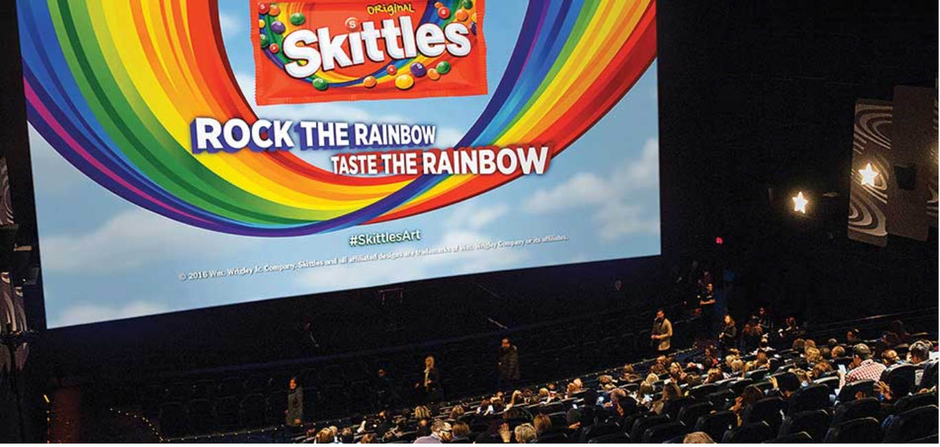
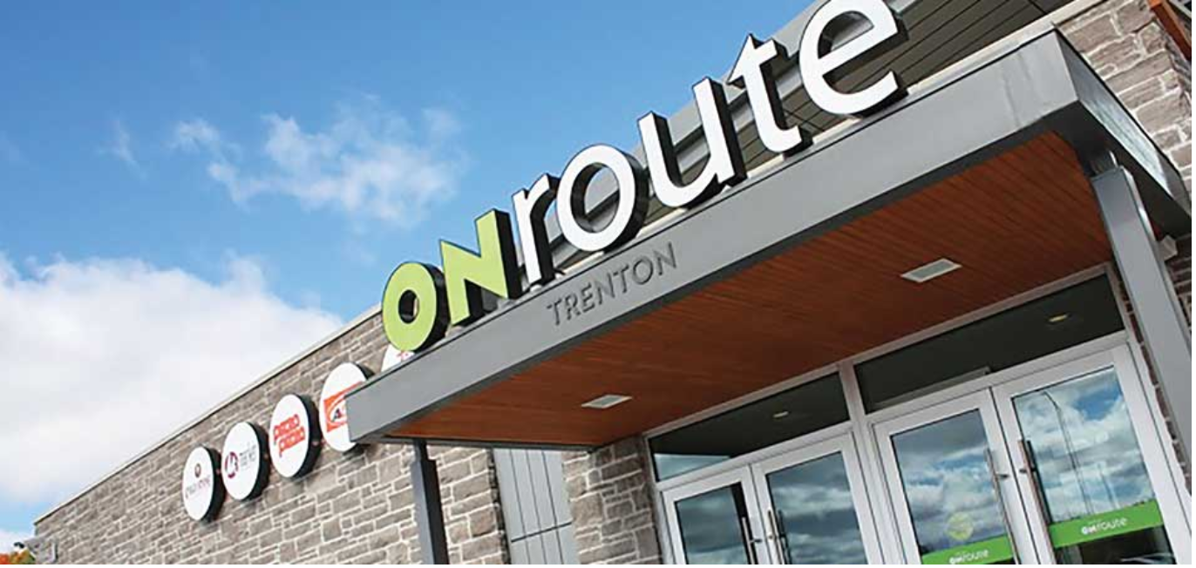
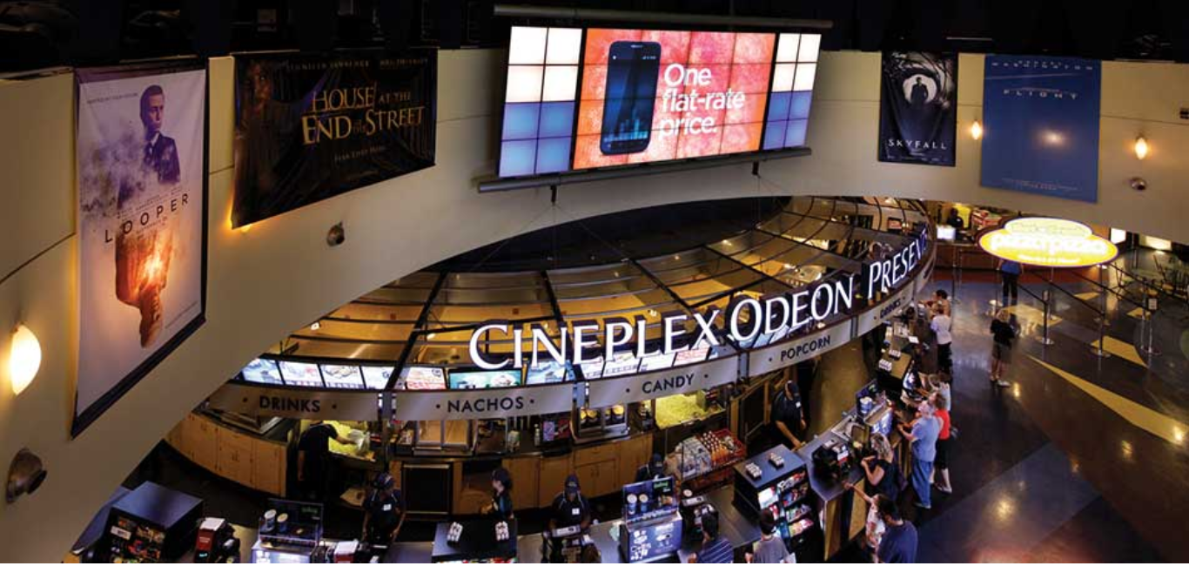

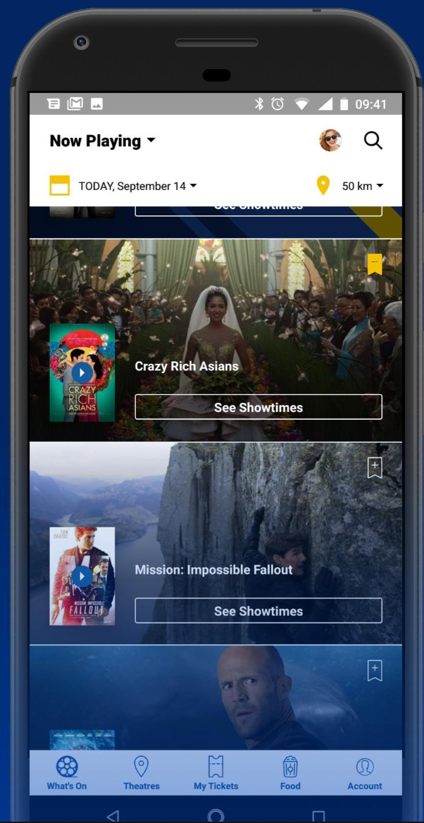
Our Solution
CineAD Ads Consultant City : Toronto / Montreal Sign In Log In
Ads Consultant :
Assist AD companies to target Media channels in order to have most AD effectiveness. It requests to enter AD budget, AD product type, AD consumers group, AD type (text, picture or video), if video, what is the quality and tech etc. Then Ads Consultant can provide TopN recommendations based on Ads effectiveness machine learning module.
Recommendation:
Pre-time show + ONroute Digital (Toronto)
2. Digital Lobby + Magazine & Cinecoin
Click to see details
Click to see details
Step 1
Step 2
Step 3
Step 4
Please Enter your AD budget:
Please Choose your AD product type:
Please Choose your Consumer’s Group
Please enter your AD type
$50,000
Food
Car
Clothes
Bank
Travel
Cosmetics
Real Estate
Electronics
Video
Picture
Text
Interactive AD
18
65
100
Submit

Slide 16
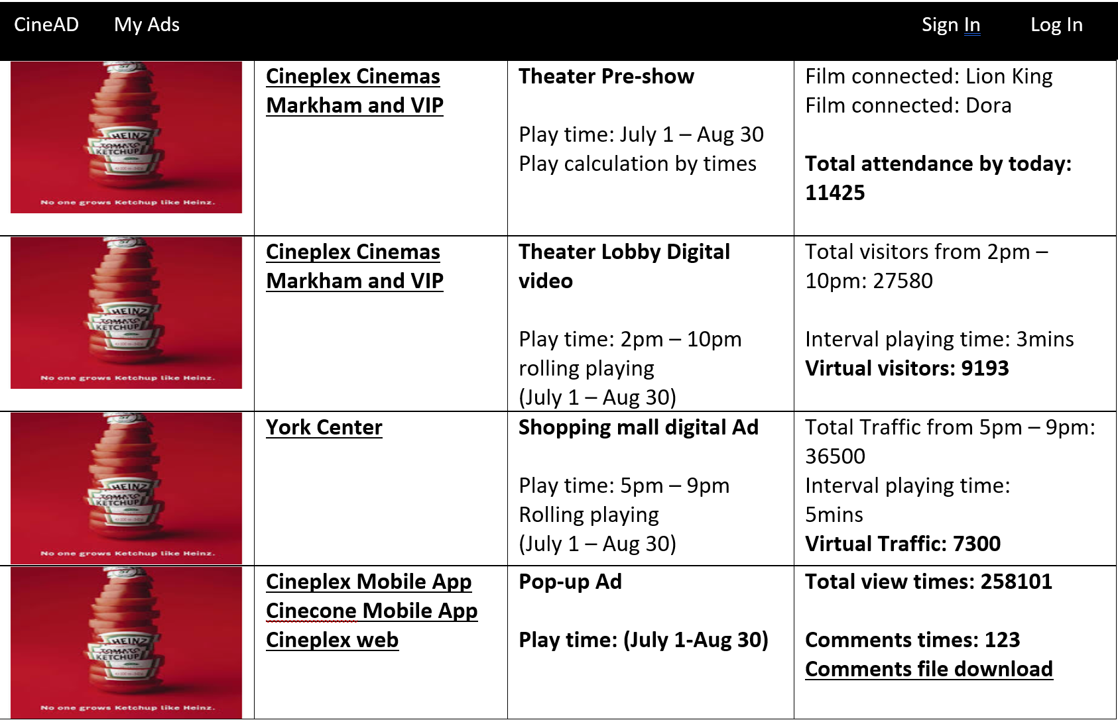


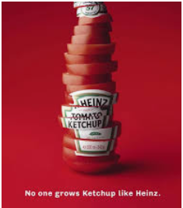
Our Solution
My ADs :
to monitor their ADs operation status and account status. Use below as an example: Once you enter My Ads, it will list all the contracted Ads.

Slide 17
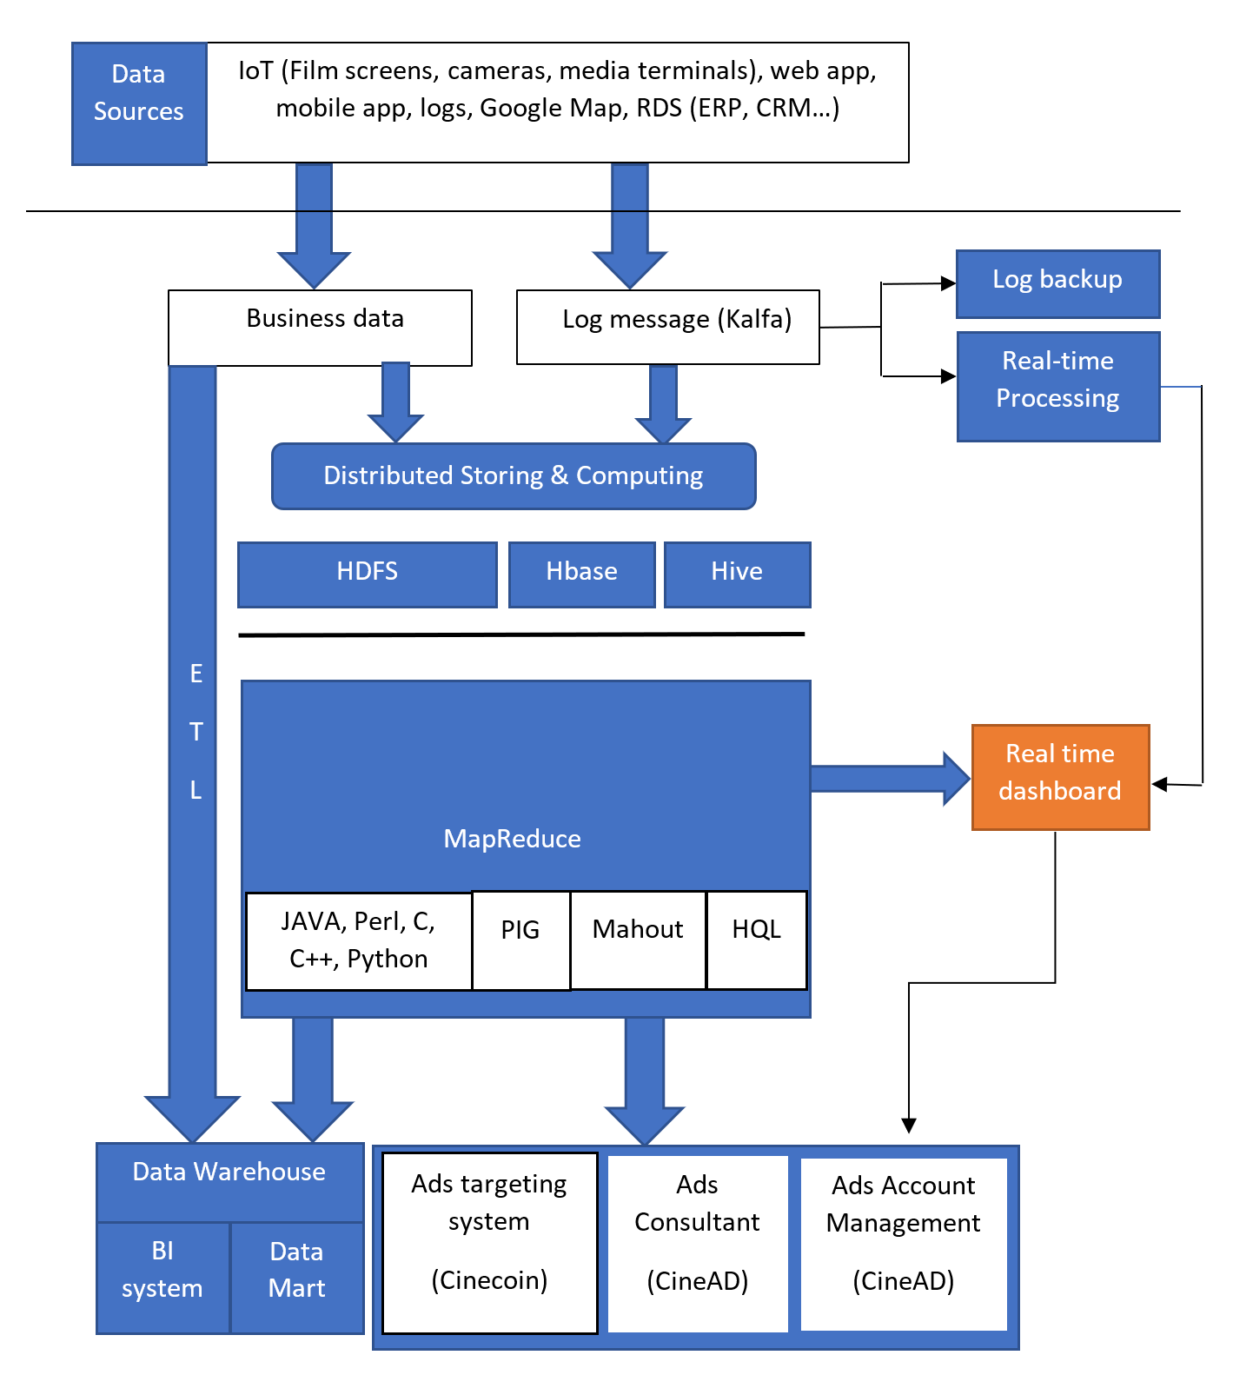
Our Solutions
Data infrastructure
Software: Data warehouse (using current one), Hadoop eco (Data lake + computing), Real-time Data processing platform (Google Cloud), google map (API)
Hardware: Cameras installing on AD terminals & Theater lobbies

Slide 18
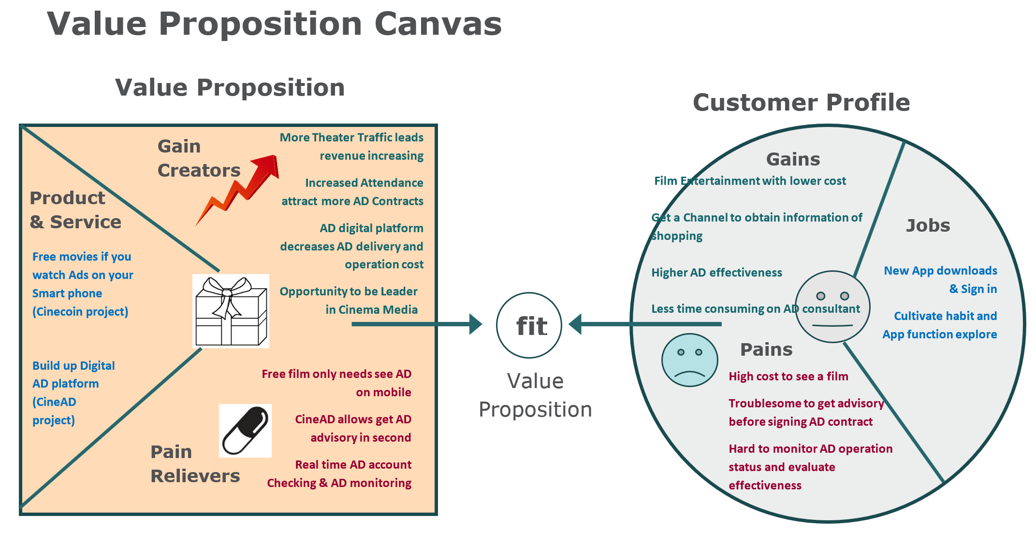
Our Solutions
Value Proposition

Slide 19
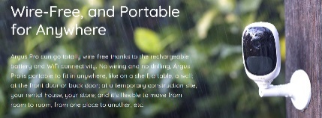
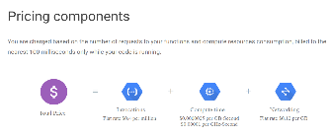
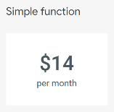
Our Solutions
ROI Analysis
Value increased:
Investment cost:
More Theater Traffic leads film segment revenue increasing, including (Food revenue, theater-based amusement consuming) | Each year average 700,000 attendance and average 3.9 film per person, so actual viewer quantity is 179,000 and we can hope the free ticket mostly generated in these movie fans, and each fan has yearly 1.5 free tickets. So, the estimated increasing of attendance is 287,000 and based on the rate of food consuming, we can expect food increasing revenue will be approximately 180.82 million.
Increased Attendance attracts more AD Contracts revenue | As per the rate of theater attendance and theater-based Media revenue, we can expect 30.67 million ADs revenue increasing.
Integral AD digital platform creates new AD Contracts | The AD effectiveness increasing and AD business operation and management convenience can greatly enhance the Loyalty of customer, it will be increasing repeat business and long-term business scale. Here we take 1-year operation hypotheses, we can expect 30% increasing based on 2018 Media revenue: 165 * 30% = 49.5 million
Decreased labor and operation cost | Currently, the Media business service mostly is off line and based on traditional consultation, contract management and AD effectiveness evaluation. Once the digital platform built up, Media price, location, where to place Ads and How much people had viewed my AD contents all can be all done on line with real time processing ability. Operation cost could be dramatically decreasing on Sales / Marketing dept. We can expect 25% cost down based on last year’s Costs of operations 1492800 * 25% = 3.75 million
Hardware purchasing cost (wireless + waterproof + day& night camera purchasing, price $78.99 each) | There are 164 Theatres, each Theatre should install at least 1 camera at entrance. There are total 56 shopping center with total 652 Media terminals, thus each terminal need installs 1 camera. There is no need to install camera in Tim Horton and ONroute, since the Ads placed on TV screens, which has already data collected from wifi. Therefore, the total cost will be $78.99 x 816 = $83792
Software purchasing cost: Google Map + Google cloud | Google Map price is based on clicking times, estimated clicking won’t be too large at the first three month, $100 per month, $1200 per year. Google cloud price: $14/camera *816*12= $137088 per year
Software developing cost | It needs normally 10 software developer, estimated salary 100,000 * 10 = $1000,000
Internal training cost | Training program for these two projects App training, we can estimate employee = 13000 total employee * 15% (Media share) *0.5 =975 employees 975*7h*$20= $136,500
Food cost | As per above estimated traffic increasing is 195000, food increasing 122.77 million, food cost is almost 25% = 30 million

Slide 20
Our Solutions
Hard & Soft Benefits
Free movies by watching Ads on smart phone, this strategy can assist to collect a huge user’s data.
Attribute | Cineplex whole organization
Benefit | 180.82 million+30.67 million+49.5 million+3.75 million = 264.74 million
Investment | $83792 + $1200 + $137088 + $1000,000 + $136,500 + 30 million = 165.85 million
Net Present Value (NPV) | 98.89 million
Return on Investment (ROI) | 60%
Opportunity to be leader of Cinema Media.
Hard Benefits
Soft Benefits
Both projects can upgrade customer’s satisfaction, it will bring reputation for Cineplex.
Cinecoin could use cryptocurrencies as a source of cost reduction (you don't pay bank fees) and innovation

Slide 21
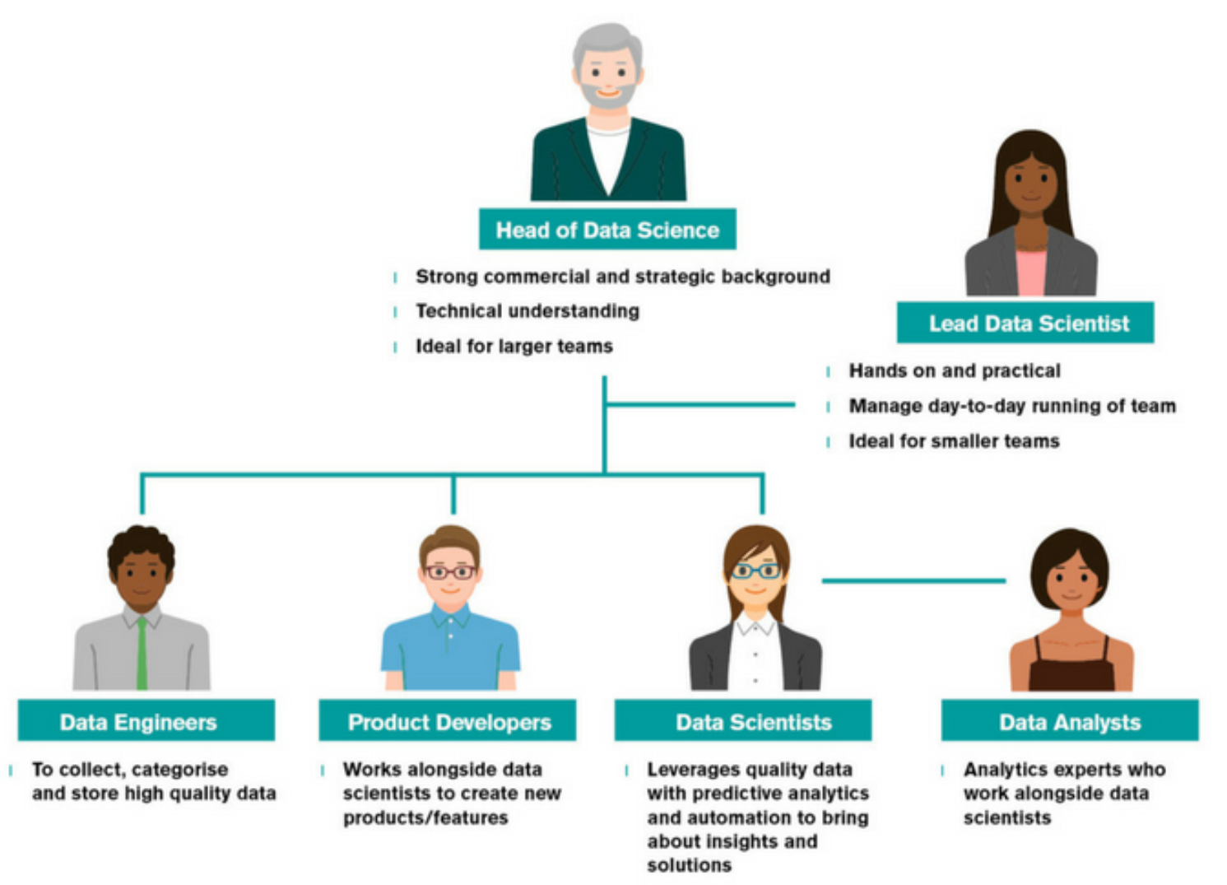
Project Planning
Data Team
1 Head of Data Science
1 Lead Data Scientist
2 Data Engineers
1 Product Developer
1 Data Scientists
1 Data Analysts)

Slide 22
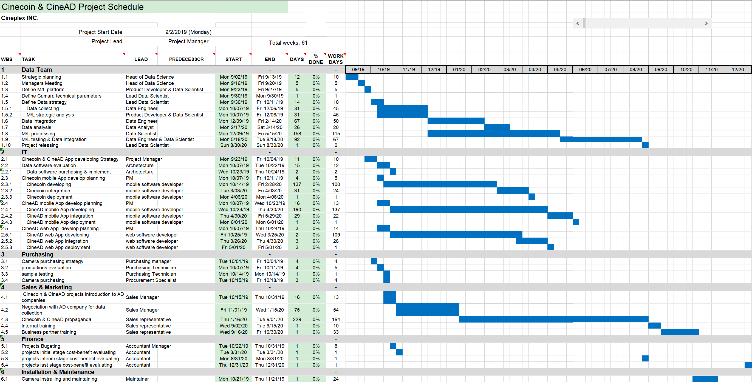
Project Planning
Road Map

Slide 23




Project Planning
Risk & Challenges
Create a win-win business model.
A digital AD platform will benefit AD company themselves. They provided data and Cineplex will use data to provide more effective AD placing strategies for AD companies.
Data Challenge
It is a big challenge of obtaining the History Data from AD companies regarding the advertisement effectiveness and Traffic pattern data from shopping centers. They may have concerns of data privacy.
And also the evaluation of AD effectiveness is complicated itself, they may also lack of accurate data.
01
There is free trial from Google Cloud. We may install few cameras at the very beginning of the project and to see the actual cost of real time image processing.
Cost Challenge
02
The estimated cost of Google Cloud is not very accurate because it is hard to estimate the data volume of receiving and calculating by real time processing model.
Need more communication with IT team and data architecture in order to make sure the data infrastructure is realizable.
Data Security Risk
The Big data infrastructure may not be optimized, it may cause low performance and high cost and security vulnerability
03
Protect the privacy of the customers and won’t share data with another stakeholder
Protect consumer’s portraiture rights (image took from the camera)
Use information only for what we want to disclose the purpose
Set up Data protection officer and limits of authority of obtaining data
Legal & Ethic Risk
04
Cameras installation may be illegal or need permission from third parties.

Slide 24
v
C⁺D
TEAM
Lan Xu
C+D = E+F (Entertainment Future)
Jennifer Pierre
Xi Yang
EDIT TEXT

Slide 25
We won’t disappoint you!
Good Time
Good Projects
There is no use case in Cinema Media industry to have real time monitor and intelligent consultation service.
Big data in business strategy should be a new vision of executives and it will assist Cineplex to keep the leadership.
Projects are compliance with Company’s vision.
Cinecoin takes full advantage of film segment, low cost, short investing period, large market effect, it creates revenue and it is also an innovation of collecting big data.
CineAD is designed on current Media Platform, use data and machine learning to benefit customer, which is helpful for deep cooperation with AD companies and enhance profitability.
Good Team
We work hard, step by step, projects are designed and analyzed based on true data, scientific methodology. We considered challenges and we proposed the solutions, we saw the risks but they are under control.
The Machine Learning models (Recommendation) has already applied and proved its effectiveness in many use cases.

Slide 26

C+D
Thank You
E+F

